Slide 1

Community Health:
Statistical Analysis Report
Andrew Tumwesigye

Slide 2
Background
This is a synthetic health and lifestyle dataset designed to simulate real-world population data for statistical analysis and predictive modeling. It combines demographic, behavioral, physiological, and genetic variables to reflect how multiple factors interact to influence health outcomes.
The dataset includes both numerical and categorical variables, allowing for a wide range of analyses such as t-tests, ANOVA, chi-square tests, regression modeling, and classification. Key health indicators like BMI, blood pressure, cholesterol, and glucose levels support medical-style interpretation, while behavioral factors such as exercise, sleep, smoking, and alcohol consumption add lifestyle context.
A binary outcome variable, DiagnosisRisk, enables logistic regression and classification analysis, while the inclusion of time-based data allows for trend and forecasting exploration.
Overall, the dataset was built to be analytically rich and realistic in structure, supporting both exploratory and advanced statistical techniques.

Slide 3
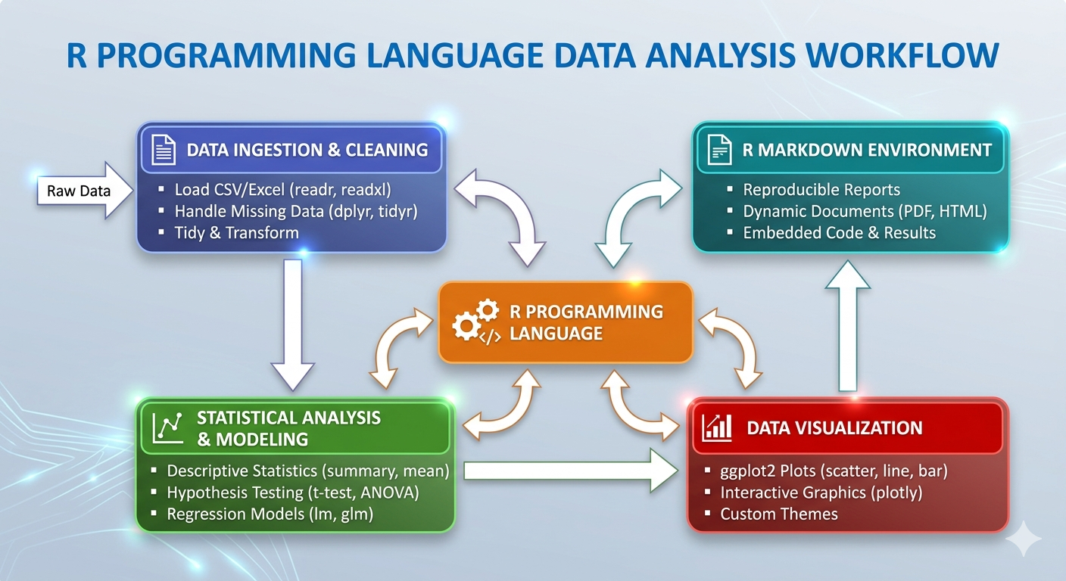
Tool utilized
This analysis was conducted using R, which supported the full data workflow from start to finish.
Data ingestion & cleaning, ensuring the dataset was analysis-ready.
Statistical analysis and modeling, including hypothesis testing, regression, and exploratory data analysis.
Data visualization to support pattern discovery and interpretation of results.
R Markdown environment to integrate code, analysis outputs, and narrative text into a structured and reproducible report.

Slide 4
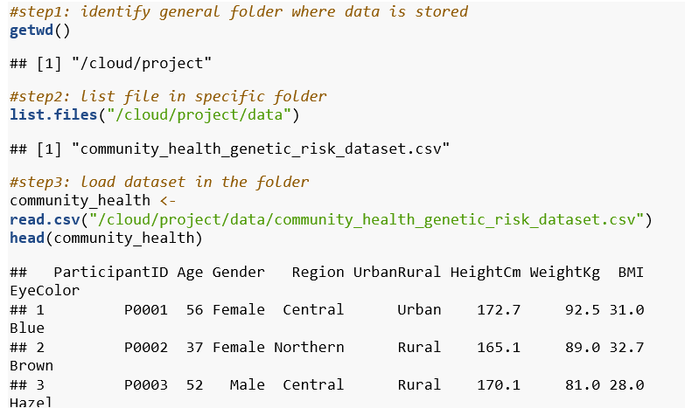
Phase1: loading the dataset
Identify working directory
Main folder where subfolders are stored
Verify data files exist
List files in the subfolder to verify data is there
Load the data
Read the CSV file into R and preview the first few rows

Slide 5
Phase2: Analysis & Findings

Slide 6
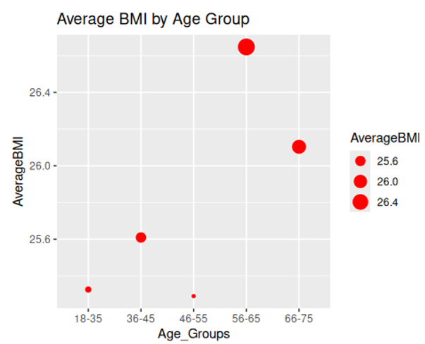
Average BMI across different Age Groups
The goal here is to establish how BMI fluctuates by age group.
Using the cut, break and labels function, I created age groups from participant ages and then created a new age group column using mutate function .
I calculated the average BMI and grouped by the new age group column as indicated in the chart.
Findings indicate that age group 56-65 has the highest BMI readings while 46-55 has the lowest with 18-35 slightly above it

Slide 7


Glucose & Systolic-BP summary
What is the standard deviation of glucose levels?
The purpose of sd is to calculate how much glucose readings spread out from the average.
The results below indicate that glucose readings vary away by 13.74 from the average.
This suggests there is a moderate variation in glucose levels among participants.
What are the min, max and quartile values for systolicBP?
The image below indicates the following;
Participants BP centers at 145.1 which is high
Over 75% of the sampled population falls into hypertensive ranges (153.6), with the top quarter facing severe Stage 2 elevations
Individual readings span from a healthy minimum of 108.8 mmHg to a life-threatening maximum of 187.3 mmHg.

Slide 8
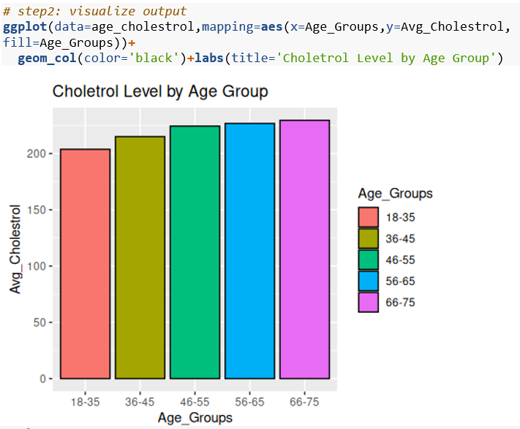
Age Group with the Highest Average Cholesterol Level
The objective here is to examine how average cholesterol levels are distributed across the 5 age groups
To establish this, I calculated the average cholesterol and grouped by newly created age group
Findings indicate a positive correlation: Average cholesterol levels consistently rise as age groups increase.

Slide 9
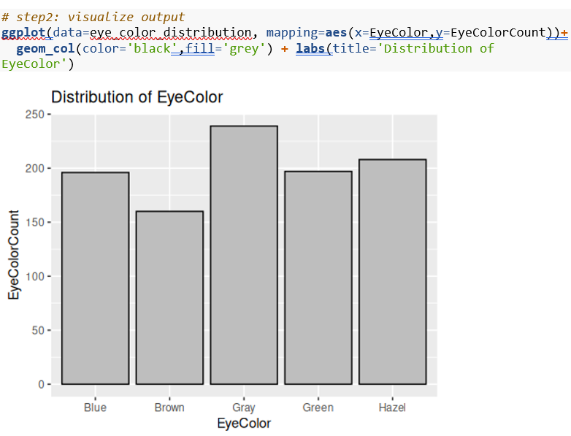
Distribution of Eye Color among participants
The objective is to determine how eye color varies amongst participants.
To do this, the count function was used to group participants by eye color and calculate the number in each category.
Outside of the peak in Gray and drop in Brown, the population shows a relatively even distribution across other categories.

Slide 10
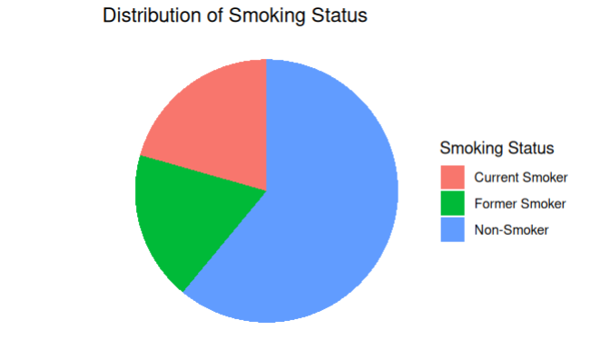
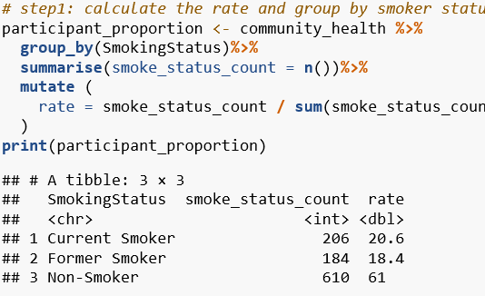
Proportion of Participants in the smoking Status Category
Participants were divided by smoking status (e.g., current, former, never). For each status, I aggregated the actual number of people in that group, and the percentage they make up of the total study population.
Insights:
Most of the tracked participants (combining Non-Smokers and Former Smokers) do not currently smoke.

Slide 11
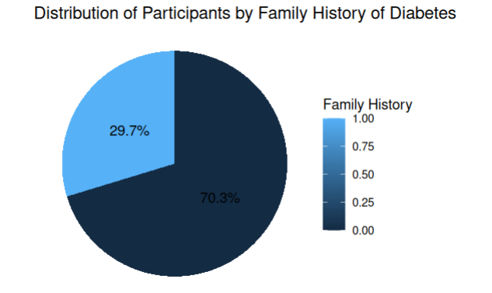
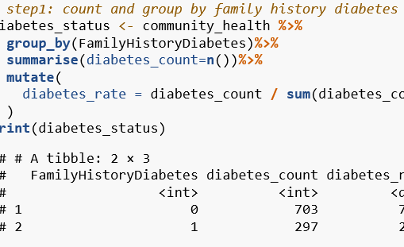
Rate of Participants with & without a Family History of Diabetes
To answer this, I grouped participants based on whether they have a family history of diabetes. For each group, the count of participants was carried out.
This was followed by a calculation of the percentage each group represents out of all participants.
Insights:
The majority of participants (70.3%) do not have a family history of diabetes indicated by 0 while (29.7%) carry a family history of diabetes indicated by 1

Slide 12
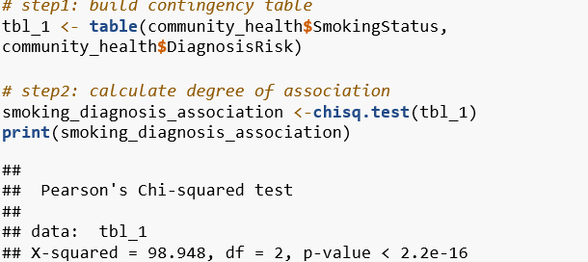
Is smoking status associated with diagnosis risk?
I used the chi-square test to measure association between smoking status (current/former/non-smoker) and diagnosis risk (true/false).
Results to the right indicate;
The p-value (2.2e-16) is less than the alpha value of 0.05 meaning we reject the null hypothesis and conclude that there is a statistically significant association between the variable.
The large chi-square value (98.95) indicates that the observed distribution is extremely unlikely to have occurred by chance alone.

Slide 13
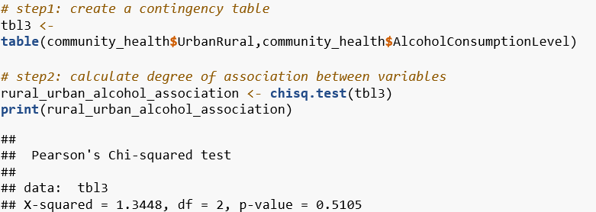
Is Urban Rural Dwelling Associated with Alcohol Consumption?
I used the t.test to compare the difference in means for rural and urban dwellers
Results to the right indicate;
There is no statistically significant association between the variables since (p = 0.5105 > 0.05).
The very low chi-square value (1.34) confirms that the observed distribution is very close to what would be expected by chance alone.
In conclusion, no relationship exists, the variables are independent.

Slide 14
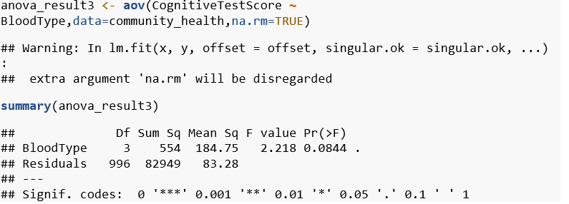
Do Cognitive Scores Vary Across Blood Types?
I used the anova test to establish if there is a significant difference in means of 4 different blood types (A, B, AB, O)
The results on the right indicate;
p-value (0.0844) > alpha (0.05), therefore we fail to reject the null hypothesis.
However, the result is marginally significant (p < 0.10), suggesting a weak trend that does not meet conventional statistical significance.

Slide 15
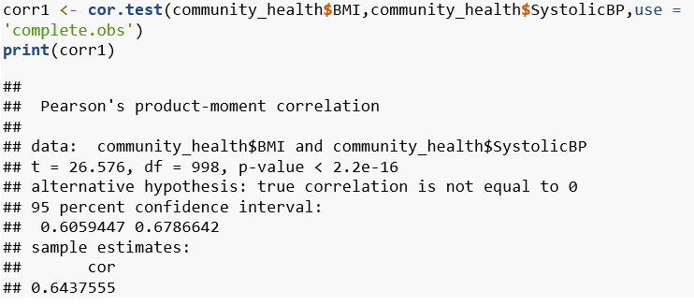
Is there a Correlation between BMI and SystolicBP
I used the correlation test to establish whether the relationship between BMI and systolic BP is negative, positive or null.
The results to the right indicate;
Since p-value (< 0.001) < alpha (0.05), we reject the null hypothesis.
In conclusion, there is a statistically significant, moderate-to-strong positive correlation between BMI and systolic blood pressure (cor = 0.644 and p-value < 0.05).

Slide 16
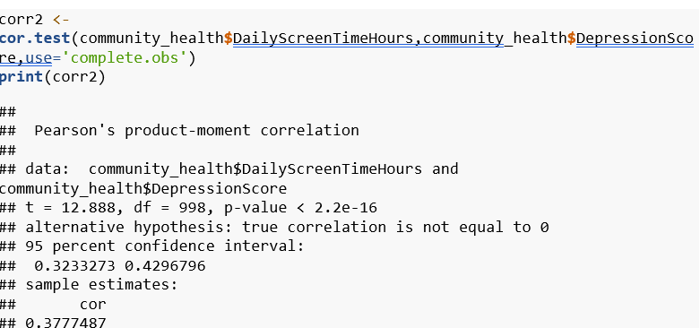
How Strongly is Daily Screen Time Hours Related to Depression Score
I used the correlation test to establish whether the relationship between daily screen time and depression score is negative, positive or null.
Results to the right indicate;
Since p-value < alpha (0.05), we REJECT the null hypothesis.
In conclusion, there is a statistically significant, weak to moderate positive correlation between daily screen time and depression score (r = 0.3777, p < 0.001).

Slide 17
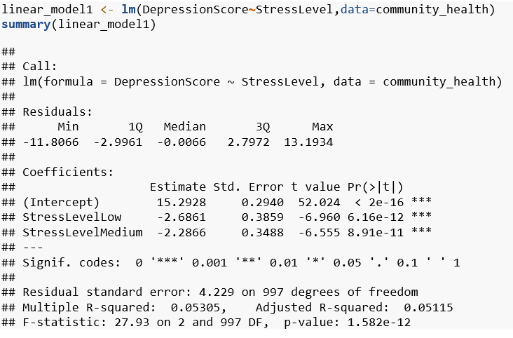
Does Stress Level Significantly Predict Depression Score
I built a linear regression model to examine whether stress levels can predict depression score
The results on the right indicate the following;
The intercept value of 15.2928 represents the estimated depression score for the reference stress category (StressLevelHigh)
Compared to the reference category above, participants with low stress had depression scores lower by 2.6861 points, while participants with medium stress had depression scores lower by 2.2866 points.
Both relationships were statistically significant (p<0.001<0.05). In conclusion, stress level significantly affects depression score.

Slide 18
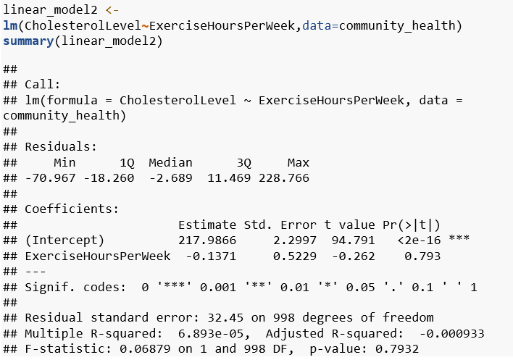
Can Exercise Hours Per Week Predict Cholesterol Levels
I built a linear regression model to examine whether exercise hours per week can predict cholesterol levels
The results to the right indicate;
The predicted average cholesterol level for someone with 0 hours of exercise per week is 217.9866.
For each additional hour of exercise per week, cholesterol level decreases by only 0.14, but this effect is NOT statistically significant (p = 0.793 > alpha 0.05)

Slide 19
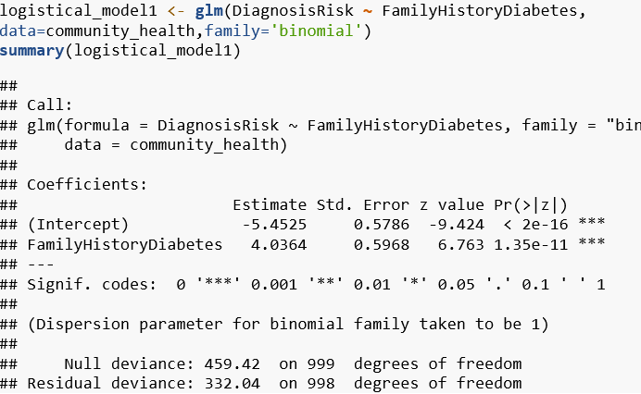
Does Family History Diabetes Significantly Increase Disease Risk
I built a logistical regression model to predict the outcome(diagnostic risk) using independent variables (family history)
Results to the right indicate;
Intercept = -5.4525 indicates that without family history the chance of high diagnostic risk is very low.
Since p-value < 0.05, we REJECT the null hypothesis
In conclusion, people with a family history of diabetes are 56.6 times more likely to be at high diagnosis risk (applied exponential function to 4.04 to derive 56.6)

Slide 20
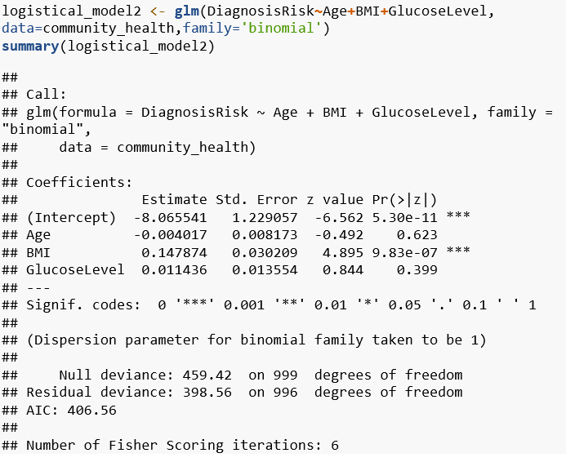
Can Age, BMI, Glucose Level & Stress Level impact Diagnostic Risk Outcomes?
I built a logistical model to predict how the independent variables above influence the categorical outcome
Results to the right indicate;
When Age = 0, BMI = 0, and GlucoseLevel = 0, the intercept indicates a very low baseline probability of the outcome.
Age had a coefficient of -0.004017, meaning increasing age slightly decreased the odds of the outcome.
BMI had a coefficient of 0.147874, meaning increasing BMI increased the odds of the outcome.
GlucoseLevel had a coefficient of 0.011436, meaning increasing glucose level slightly increased the odds of the outcome

Slide 21
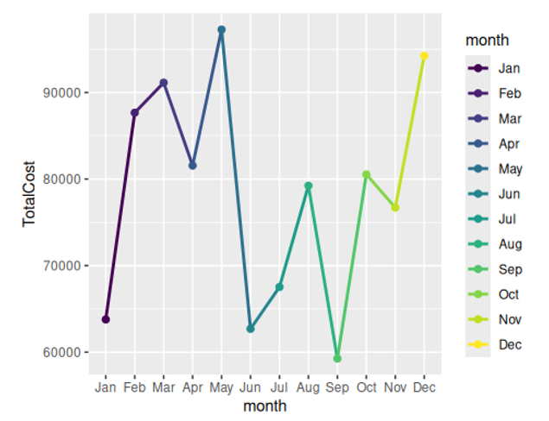
How does Monthly Medical Cost Trend over Follow-up Month?
To establish the monthly trend, I created a new month column using mutate function, then grouped by month and aggregated cost.
The line graph indicates the following;
Total costs hit their absolute highest point in May.
There were sharp drops in spending in June and September
The final quarter (Oct to Dec) shows a strong upward trend

Slide 22
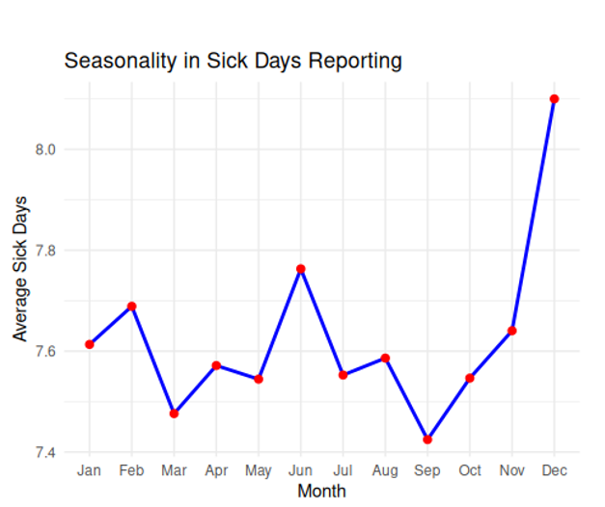
Is there Seasonality in Sick Days Last Year Reporting
To establish this, I grouped the data by the month column and calculated the average number of sick days per month
The line graph indicates;
General Volatility: The data shows a "sawtooth" pattern with frequent ups and downs, but the average remains largely within a tight band (7.4 to 7.8) until the major December outlier.

Slide 23
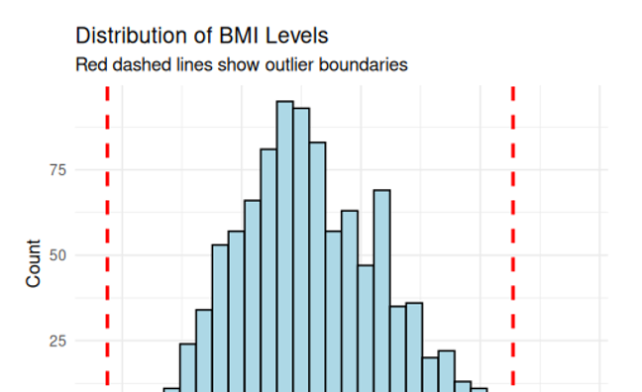
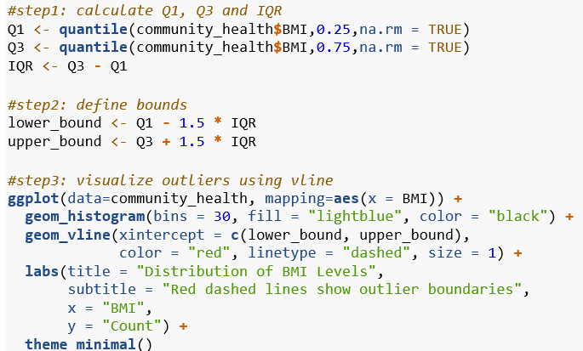
Which Participants Have Abnormally High or Low BMIs
Central tendency: most frequent BMI values (the peak) falling between 23 and 27, which aligns with the "Healthy Weight" to "Overweight" boundary.
Slight Right Skew: The data trails off more gradually toward the higher BMI values (the right side), indicating a larger segment of the population in the "Obese" range compared to the "Underweight" range.

Slide 24

Key insights
BMI positively correlates with systolic BP
Family history strongly increases diagnostic risk
Higher screen time associated with higher depression scores
Cholesterol increases across older age groups
Smoking status significantly associated with diagnosis risk

Slide 25

Skills demonstrated
R Programming
Data Cleaning
Exploratory Data Analysis
Hypothesis Testing
Predictive Modeling
Data Visualization
R Markdown Reporting
Statistical Interpretation

